Slide 1
Car Accidents Data Analysis
UK Government data, 2005-2015
Dataset Found at: https://www.data.gov.uk/dataset/c0eec478-ef19-4234-826f-8efb9563eda2/road-safety
Github: https://github.com/HabibR101/Project_1

Slide 2
Cleaning and narrowing down of data - Jo
Over 2 million data points
Data cleaned by the following local authority areas:
300 Birmingham
302 Coventry
303 Dudley
305 Sandwell
306 Solihull
307 Walsall
309 Wolverhampton
Merged on ‘accident_index’ as this column had matched values across all 3 csv files

Slide 3
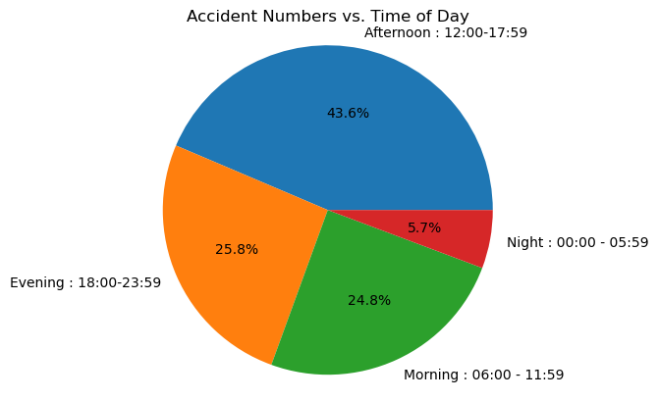
Analysis of Casualty Severities vs Time of Day- Jo
Question: When are accidents most likely to occur, based on time of day?
Filtered the data by combining accidents that have occurred during specific times of day into intervals, such that we can better assess when accidents are most likely to occur.
Morning - 06:00 - 11:59
Afternoon - 12:00 - 17:59
Evening- 18:00-23:59
Night- 00:00 - 05:59

Slide 4
Analysis of Casualty Severities vs Light Conditions- Jo
Question: What type of light conditions contribute to the severity of casualties?
In the government data file, the road safety key has defined values in column 'Light_Conditions' with the below keys-
1 : Daylight
4 : Darkness - lights lit
5 : Darkness - lights unlit
6 : Darkness - no lighting
7 : Darkness - lighting unknown
-1 : Data missing or out of range
It has also defined defined values in column 'Casualty_Severity' with the below keys--
1 : Fatal
2 : Serious
3 : Slight
We combined the data under key 5 and 6, as both involved the roads being unlit. We will be dropping the data points from key 7 and -1 as this could potentially skew or create bias in our data because we do not know if the roads were lit or not.

Slide 5
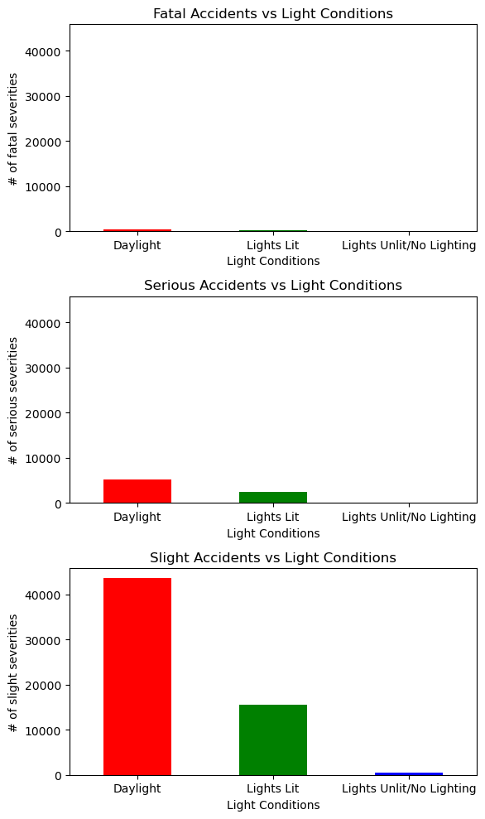
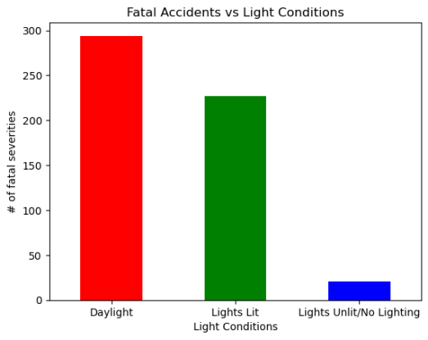
Analysis of Casualty Severities vs Light Conditions- Jo
Majority of accidents, happen during daylight hours – so what could be the reason for this?

Slide 6
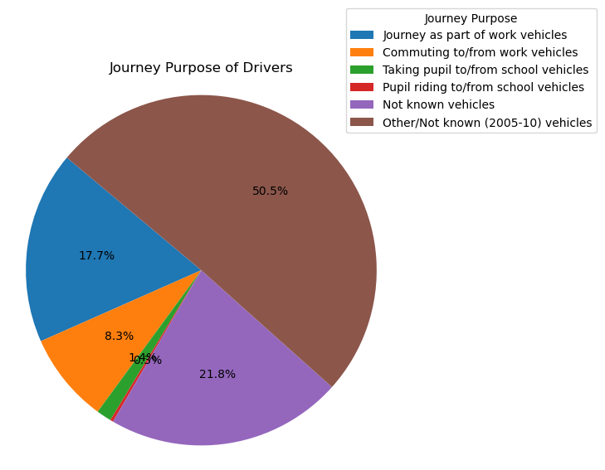
Journey Purposes- Jo
Question: why are most accidents happening in the daylight, then?
From the above bar plots, one can clearly see that accidents are happening when the roads are lit with daylight. This seems strange so we thought we would investigate this further. We wanted to see what the journey purpose was, as if most people are having accidents in the daylight hours, we would expect them to be doing school runs, work commutes etc.
The government data key shows the following, for values in column **'Journey_Purpose_of_Driver'**:
1 : Journey as part of work vehicles
2 : Commuting to/from work vehicles
3 : Taking pupil to/from school vehicles
4 : Pupil riding to/from school vehicles
5 : Other vehicles
6 : Not known vehicles
15 : Other/Not known (2005-10) vehicles
-1 : Data missing or out of range vehicles

Slide 7
Analysing Distribution of Accidents by their ‘Severity Levels’ - Maliha
Data Preparation:
Utilized Pandas DataFrames to merge 'Accident Severity' and 'Years' columns for decade-wise analysis.
Filtering:
Applied conditional logic to filter data for specific accident severities (Fatal, Serious, Slight) within a five-year timeframe.
Data Exploration:
Employed sorting and grouping techniques to gain deeper insights into the dataset.
Visualization:
Matplotlib has been used to create various graphical representations:
Pie Charts: Used to depict the distribution of accident severities.
Bar Graphs: Visualized the frequency of accidents based on different parameters.
Line Charts: Utilized for trend analysis and visualizing changes over time.

Slide 8
Accident Severity Levels- Maliha
There are three different Severity levels in our data set:
Fatal: killed
Serious: Broken neck or back, Severe chest injury, any difficulty breathing, Loss of arm or leg (or part),
Severe head injury, unconscious…
Slight: Whiplash or neck pain, Sprains and strains, Bruising, Shock

Slide 9
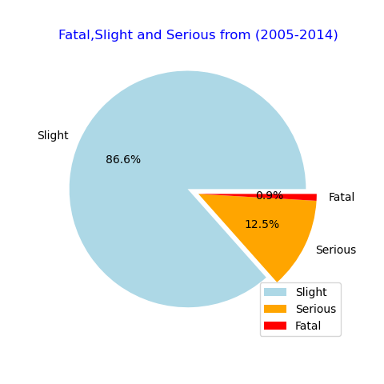
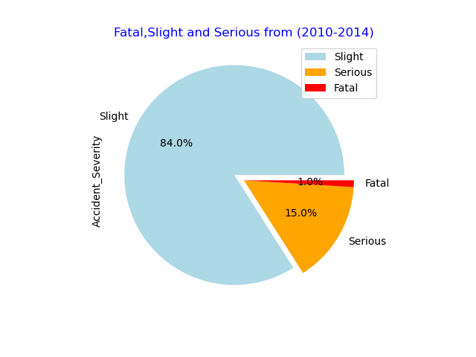
Pie charts showing the distribution of Accident Severities (Fatal, Slight, Serious) - Maliha
Accident Severity Levels from 2005 to 2014
Accident Severity Levels From 2010 to 2014

Slide 10
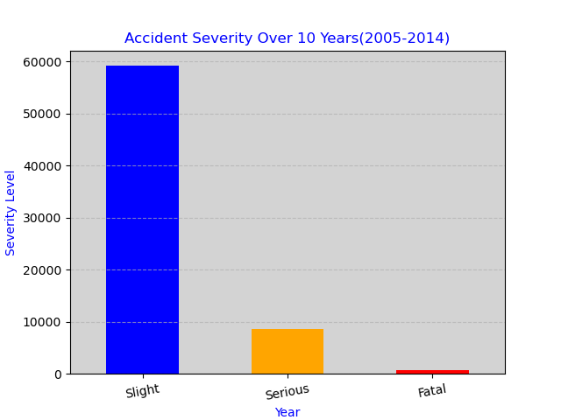
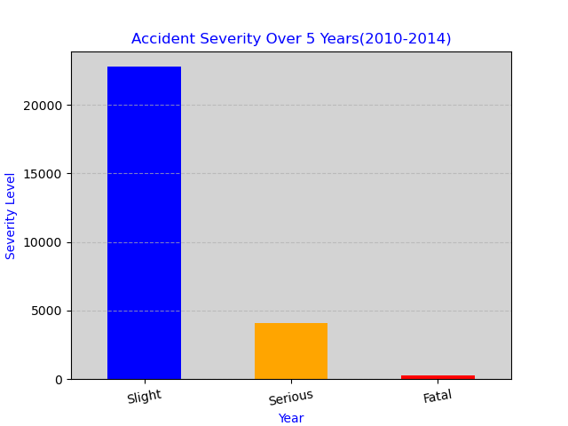
Bar charts showing the distribution of Accident Severities (Fatal, Slight, Serious)
Accident Severity Levels from 2005 to 2014
Accident Severity Levels from 2010 to 2014

Slide 11
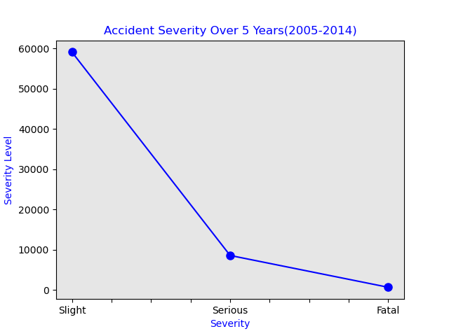
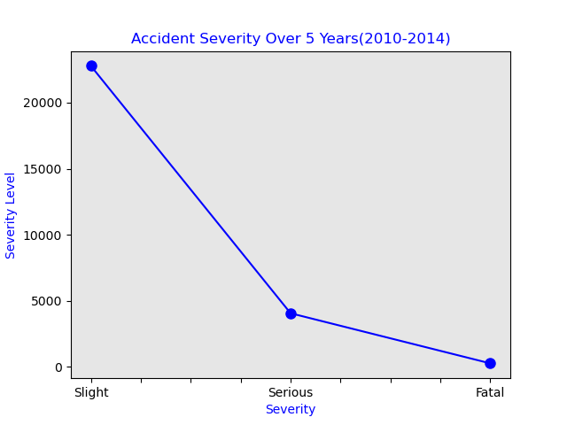
Line charts showing the distribution of Accident Severities (Fatal, Slight, Serious) - Maliha
Accident Severity Levels from 2005 to 2014
Accident Severity Levels from 2010 to 2014

Slide 12
Interpretation of ‘Fatal’ Accidents by Road Type- Maliha
Single Carriageway:
The highest number of fatal accidents occurred on Single Carriageway compared to other road types.
Single Carriageway have the highest risk of fatal accidents among the specified road types.
Travel on single carriageways is several times more risky than on dual carriageways.
Dual Carriageways:
Dual carriageways experienced a significant number of fatal accidents, but it is lower than Single Carriageway.
It's the second-highest contributor to fatal accidents.
Roundabouts:
Roundabouts have a lower number of fatal accidents compared to single_carriageway and dual carriageways.
They pose a relatively lower risk of fatal accidents.
One-way Streets: & Slip Roads:
One-way streets have a very low number of fatal accidents.
They are the safest among the specified road types. Slip roads have the lowest number of fatal accidents.
They are the least risky among the specified road types.

Slide 13
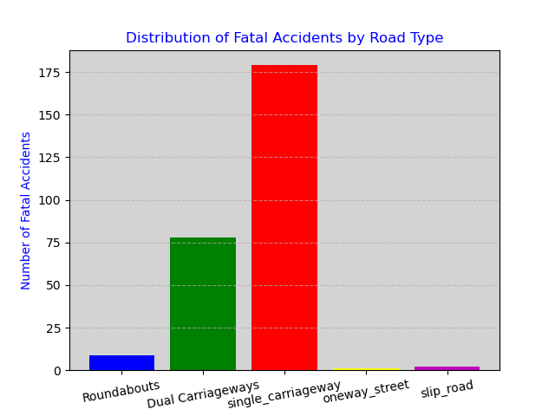
Distribution of Fatal Accidents by Road Type- Maliha

Slide 14
Distribution of Serious Accidents by Road Type - Maliha
Single Carriageway:
Single Carriageway of road has the highest number of serious accidents. This indicates that single carriageway roads may be associated with a higher risk of serious accidents compared to other road types.
Dual Carriageway: Dual carriageways have a relatively lower number of serious accidents compared to single carriageways. This suggests that dual carriageways may be comparatively safer in terms of serious accidents.
Roundabouts: Roundabouts have a moderate number of serious accidents. While they are safer than single carriageways, they still pose a significant risk compared to dual carriageways.
One-way Streets and Slip Roads: These road types have the lowest number of serious accidents. This indicates that these types of roads may be relatively safer in terms of serious accidents.

Slide 15
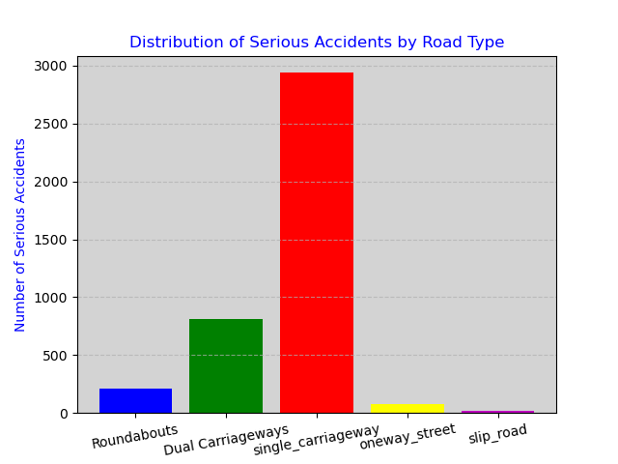
Distribution of Serious Accidents by Road Type - Maliha

Slide 16
Distribution of ‘Slight’ Accidents by Road Type - Maliha
Single Carriageway:
This type of road has the highest number of slight accidents. This indicates that single carriageway roads may be associated with a higher risk of slight accidents compared to other road types.
Roundabouts:
Roundabouts have a relatively moderate number of slight accidents. They are safer than single carriageways but still pose a significant risk.
Dual Carriageway:
Dual carriageways have a lower number of slight accidents compared to single carriageways. This suggests that dual carriageways may be comparatively safer in terms of slight accidents.
One-way Streets and Slip Roads:
These road types have the lowest number of slight accidents. This indicates that these types of roads may be relatively safer in terms of slight accidents.

Slide 17
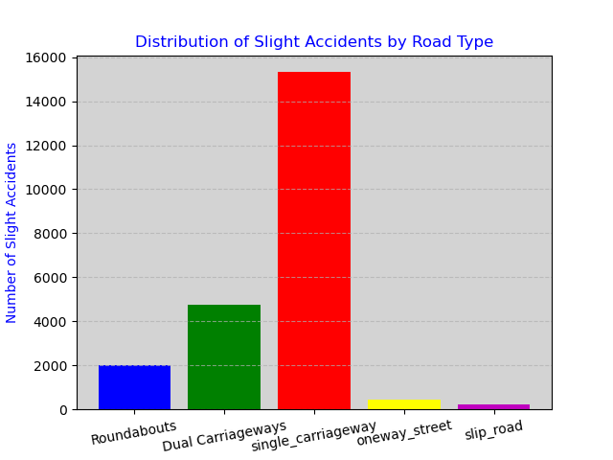
Distribution of Slight Accidents by Road Type - Maliha

Slide 18
Further Inferences
According to the Eastern Daily press:
AA president Edmund King said: 'Most drivers assume that motorways or dual carriageways are the most dangerous roads due to the higher speed of traffic.
This report clearly dispels that myth as the risk to road-users is now seven times greater on single-carriageway A-roads than motorways. Drivers need to be aware of the added risks and adapt their driving accordingly.
Overall, this analysis highlights the importance of considering road type when assessing the risk of Fatal, Slight, Serious slight accidents. It also suggests that measures to enhance safety on single carriageway roads may be particularly important.

Slide 19
Vehicle Types vs. Accident Severity - Saki
Objectives:
The data analysis aims to explore and understand the relationship between the types of vehicles involved in road accidents and the severity of the accidents.
The primary objectives of this slides are as follows:
Exploring the dataset to comprehend its structure and quality.
Formulated research questions and focusing on the impact of vehicles types on accident severity.
We made use of python, pandas and matplotlib to conduct data analysis, including statistical method to uncover the patterns within the data set.
We also used visualizations such as bar charts, and pie chats to communicate our findings and highlight any relationships or trends.

Slide 20
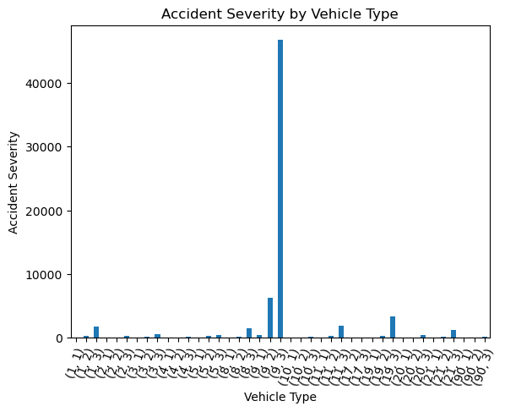
Bar charts showing the vehicle types and Accident severity
1: 'Pedal cycle',
2:'Motorcycle 50cc and under',
3:'Motorcycle 125cc and under',
4:'Motorcycle over 125cc and up to 500cc',
5:'Motorcycle over 500cc',
8:'Taxi/Private hire car',
9:'Car',
10:'Minibus (8 - 16 passenger seats)',
11:'Bus or coach (17 or more pass seats)',
16:'Ridden horse',
17:'Agricultural vehicle',
18:'Tram',
19:'Van / Goods 3.5 tonnes mgw or under',
20:'Goods over 3.5t. and under 7.5t',
21:'Goods 7.5 tonnes mgw and over',
22:'Mobility scooter',
23:'ElecElectric motorcycle',
90:'Other vehicle',
97:'Motorcycle - unknown cc',
98:'Goods vehicle - unknown weight',
-1:'Data missing or out of range',

Slide 21
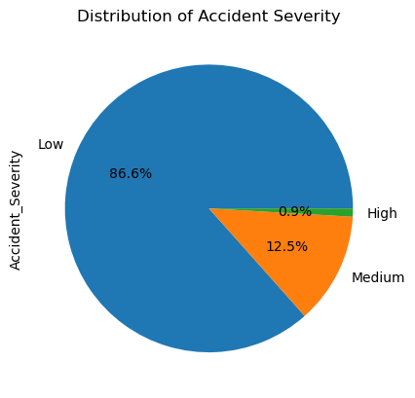
Pie chart showing the distribution of Accident Severity(High, Medium, Low) – Saki

Slide 22
Conclusion- Saki
Based on the analysis that has been conducted in this project, we can answer the main research question:
“Does the type of vehicle involved in an accident impact the severity of the accident?”
Answer :Yes, the type of vehicle involved in an accident does impact the severity of the accident, we could see in both our bar chart and pie chart that there was a noticeable difference in accident severity based on the type of vehicle involved.
It appears that HGVs have lower number of accidents, compared to cars. This shows that cars have a much higher risk of being involved in accidents.

Slide 23
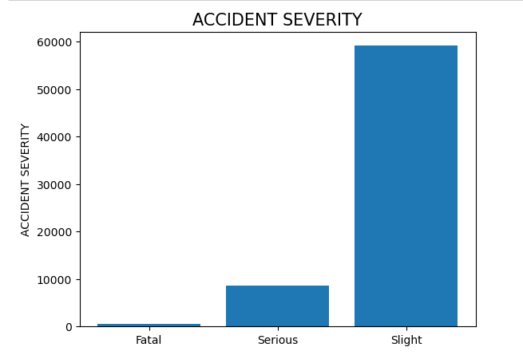
Analysing Distribution of Fatal accidents by age band and gender- Habib
Accident severity breakdown:
Filtered data shows the accident Severity break down in the west midlands area, the figures are as follows:
Key: 1 – Fatal 630
Key: 2 – Serious 8546
Key: 3 – Slight 59135

Slide 24
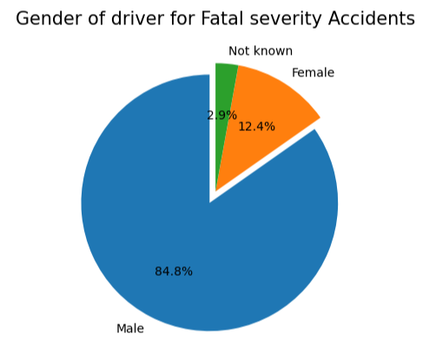
Analysis of Fatal accidents vs Gender - Habib
Question: Out of the Fatal accidents, is there a specific gender that is more prominent in these accidents?
After exploring the initial dataset of accidents, we can see in the West Midlands there are a total of 630 fatal accident. We can further investigate this by sorting by gender amongst these fatal accidents.
The data shows that out of the 630 fatal accidents 84.8% (534) are male. We can deduce that a male has a higher likelihood being involved in a fatal accident.

Slide 25
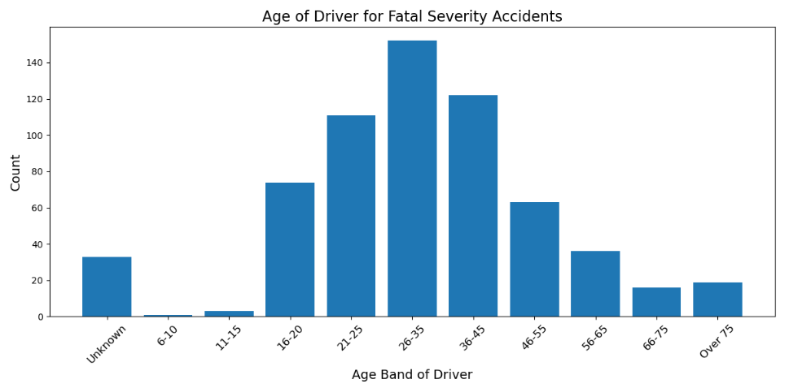
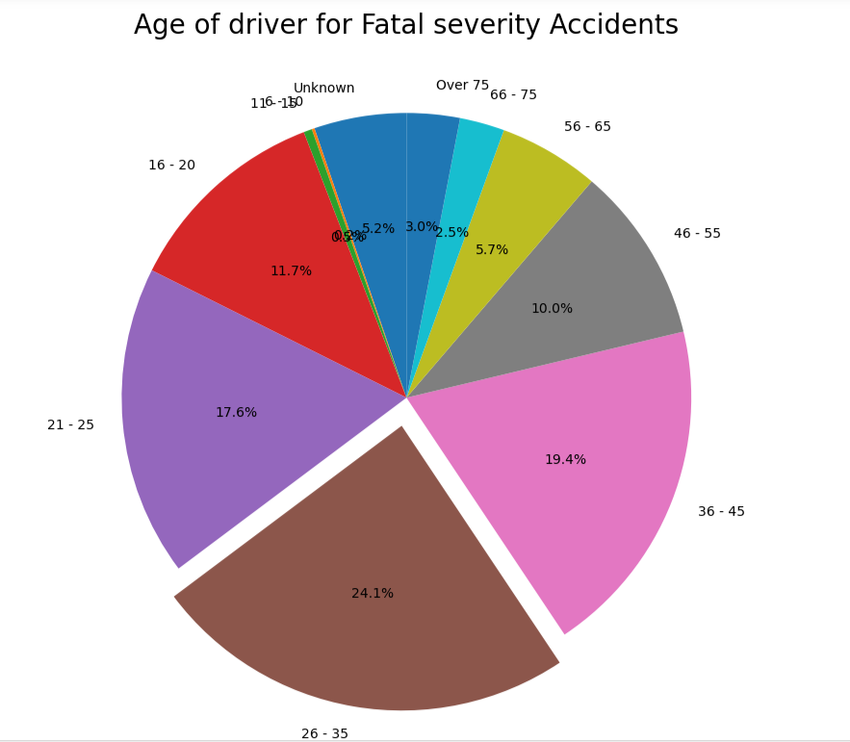
Analysis of Fatal accidents vs Age band - Habib
Question: Out of the Fatal accidents, is there a specific age band that is more prominent in being involved in the accidents?
After exploring gender factor, we then moved to looking at the age band to understand the correlation of age and fatal accident.
The data shows that out of the 630 fatal accidents 24.1% are aged between 26 – 35 across both genders. Which can imply that the age band 26 – 35 are more prone to being involved in fatal accident.

Slide 26
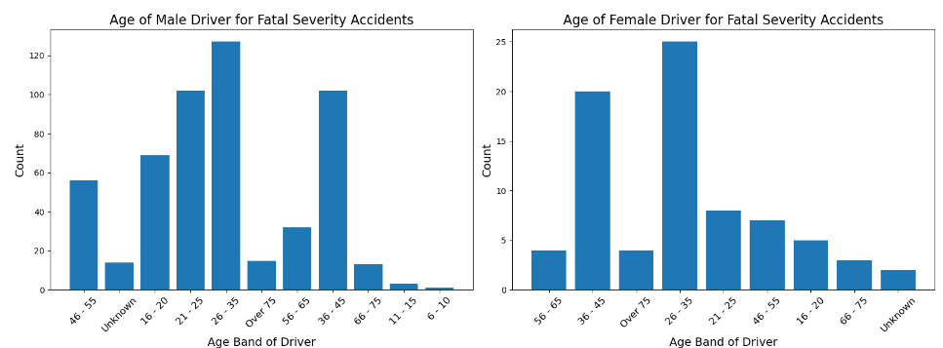
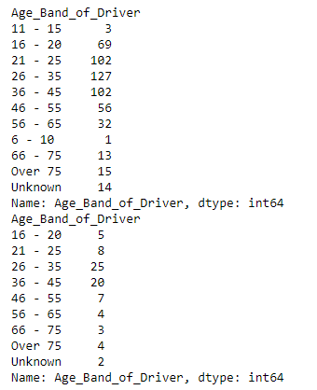
Analysis of Fatal accidents vs Gender and age band - Habib
Question: Out of the Fatal accidents, what is the relationship between age and gender?
After exploring both gender and age as factors. We then moved onto looking at the relationship of age band and gender to gain a better insight on the data of fatal car accidents.
The data shows that out of the 630 fatal accidents across both genders is the age band of 26-35. The discovery in the data can be used in Car insurance premiums as marker to show if the individuals are high risk thus generating the insurance premium for the year.

Slide 27
Summary - Jo
Insurance companies could create insurance premiums looking at the possible factors of the car accidents using our analysis.
Life insurance companies could also look at this data for ages 26-35 adults, suggesting that their premiums could also be higher due to their higher risk of fatality.
Similarly, other analysis shows that single carriageways driving have the highest risk of accidents.
Lastly, car drivers have higher risks of accidents above other types.
There are some limitations to the data –
We only looked at data from the West Midlands – note that some cities, for example London, are more densely populated therefore will have some sort of an impact on the data. This data analysis would only allow us to infer relationships in car accidents vs its factors in the West Midlands only.
We also note that the dataset only provides us data until 2015. Since then, we have had a pandemic as well a change in people’s working conditions. More people work from home, and follow hybrid working patterns than before.
More up-to-date data would be required to look at current trends, thereby facilitating more accurate pricing of insurance premiums.

